Slide 1
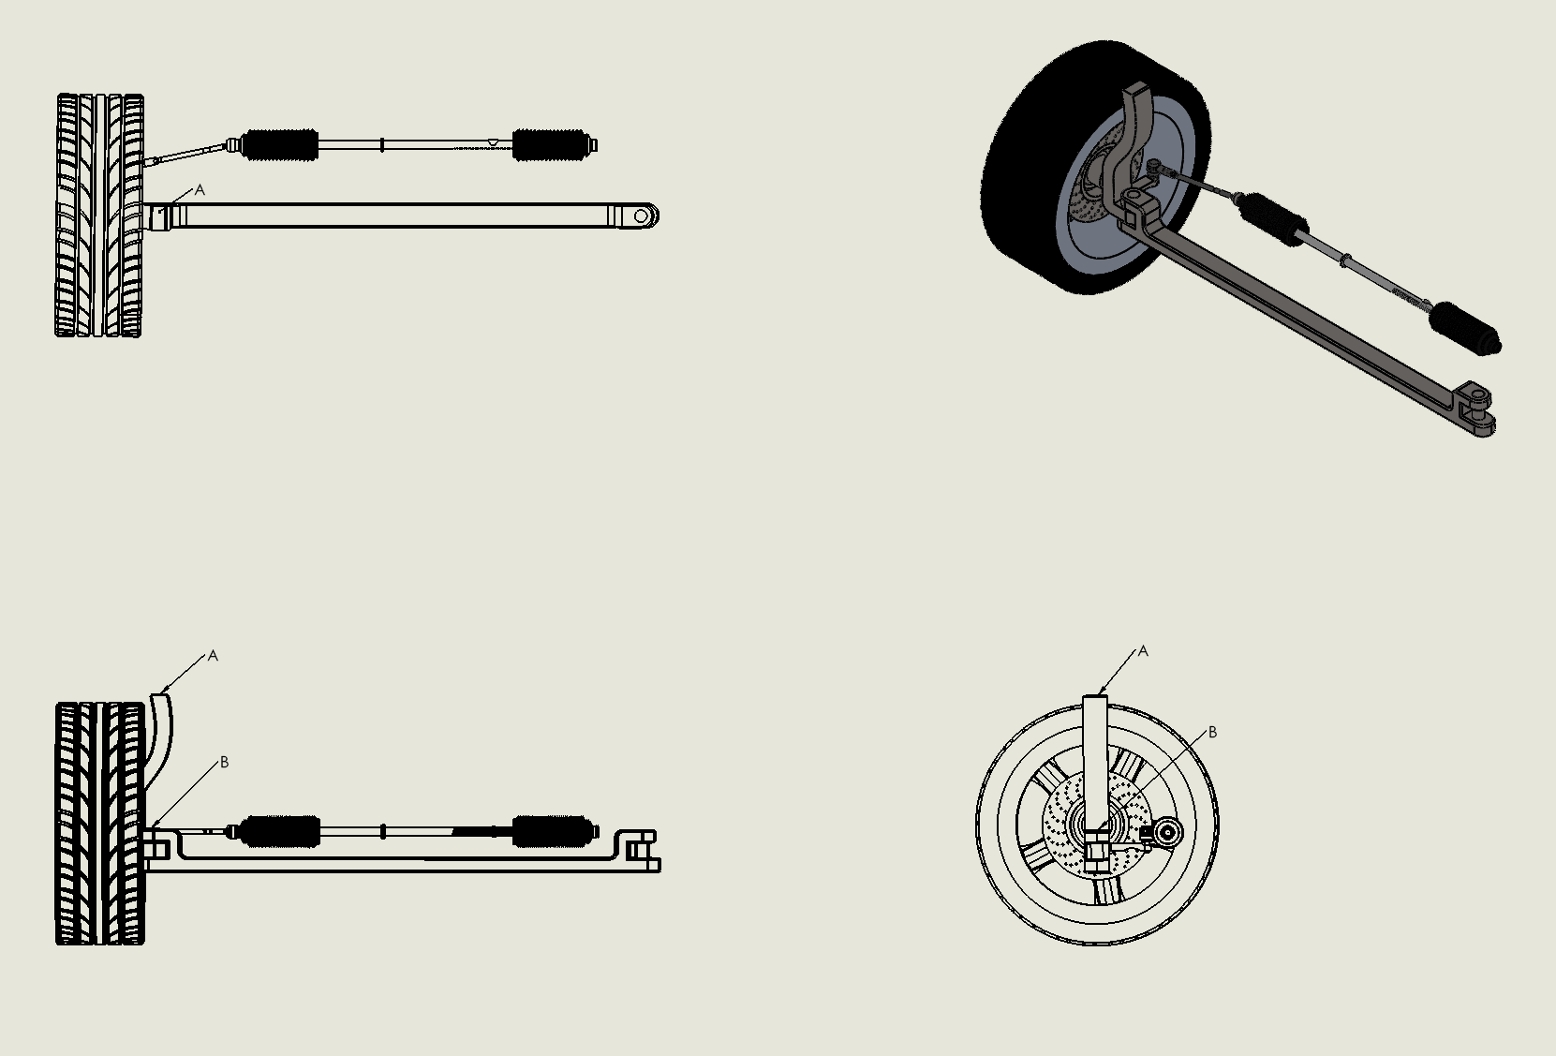
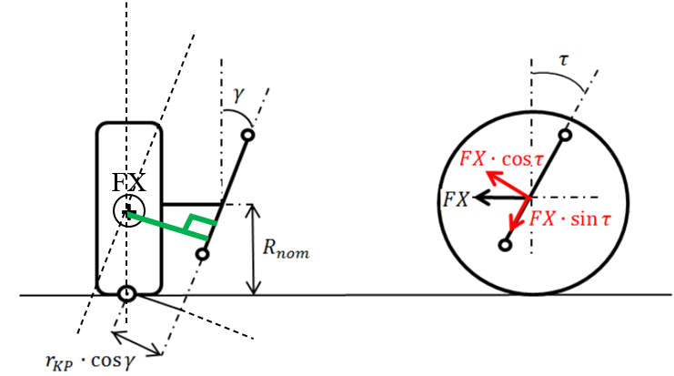


A
Top View
Fx
Front view
B
A
A
Fx
$$γ$$
B
B
$$γ$$
Side view
Fx
Side View
Fx
+
.
Front View

Slide 2
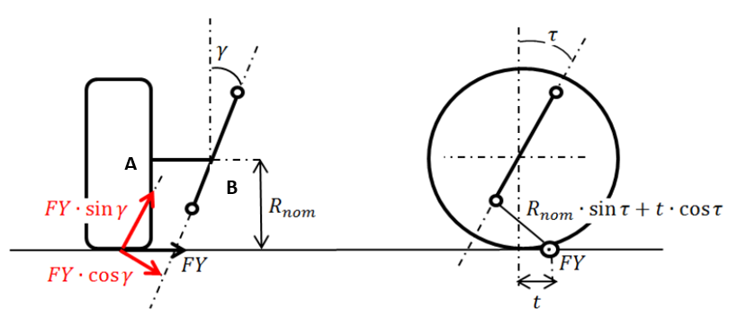



A
Top View
FY
Front view
Side view
B
A
A
A
Fx
$$γ$$
O
B
B
D
B
$$τ$$
$$γ$$
Side view
$$R_{nom}.sin⁡(τ)$$
t$.cos⁡(τ)$
Side View
Front View
+
+
FY
FY

Slide 3
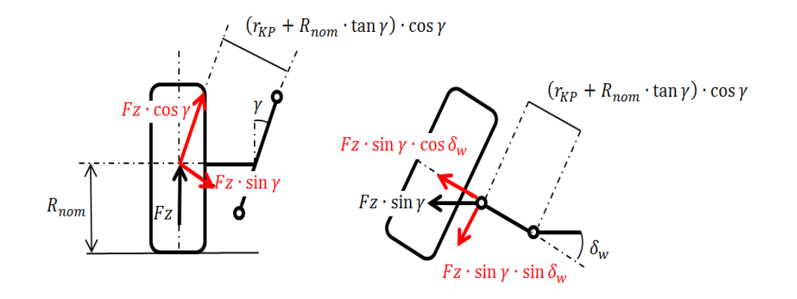
A
Fz
O
+
Top View
O
B
A
Fx
$$γ$$
O
B
A
FZ
O
FZ
O
Side View
Front View

Slide 4
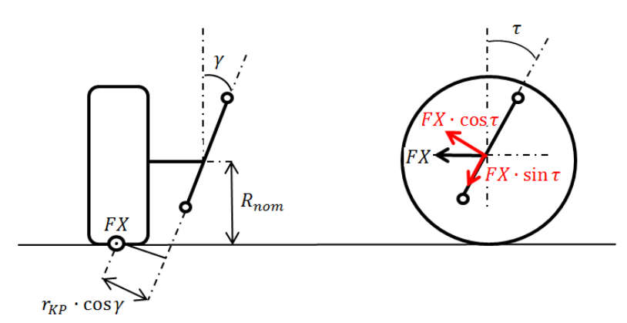
FX
+

